Slide 1
Electronic Dictionary of Old Czech
Boris Lehečka
https://vokabular.ujc.cas.cz

Slide 2
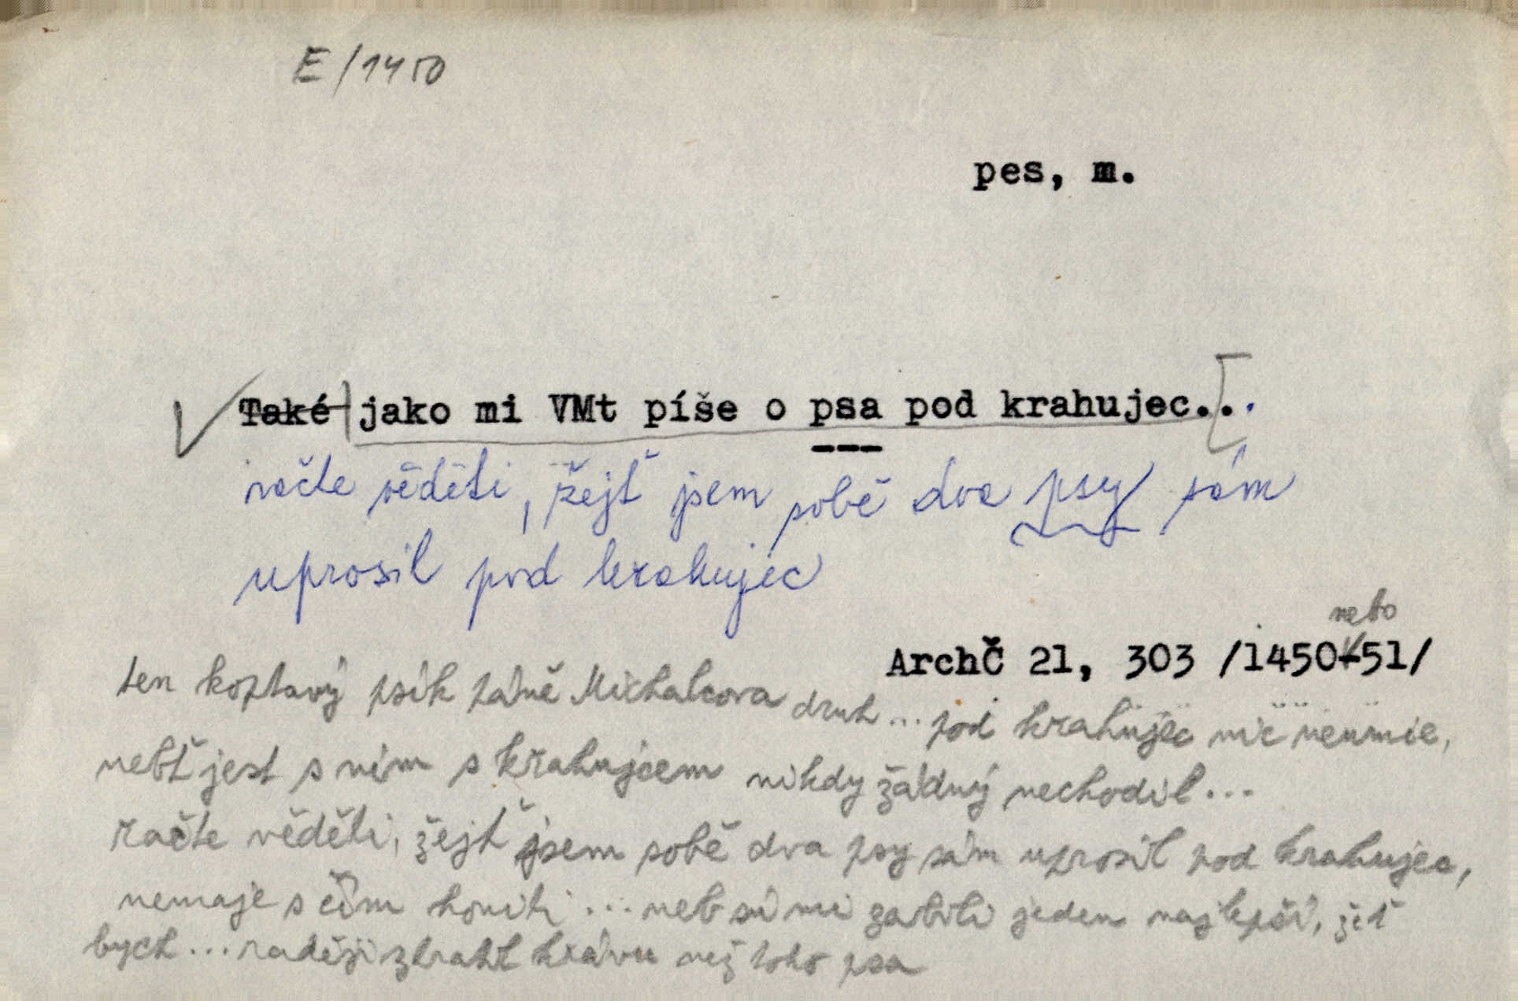
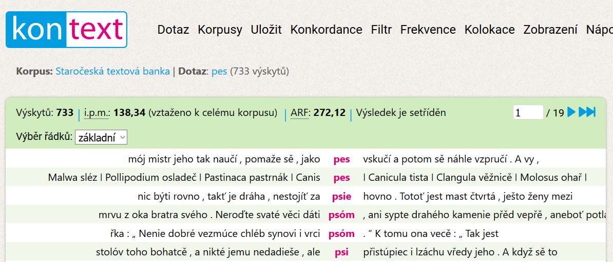
Old Czech
1300–1500
many primary sources
card index
  1.2 M cards
  lemmatized (108 K headwords)
  digitized
Old Czech corpus
  5.3 M tokens
  partially lemmatized

Slide 3
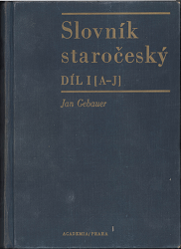

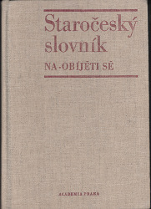
Old Czech Dictionaries
Jan Gebauer, Dictionary of Old Czech
  A–N 1903 and1916; quotations
  20,589 headwords
Small Dictionary of Old Czech
  1978, A–Ž, without quotations
  25,695 headwords
Old Czech Dictionary
  N–při, 1968–2008; quotations
  23,980 headwords

Slide 4
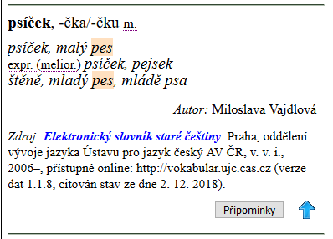
Electronic Dictionary of Old Czech (EDOC)
born-digital (based on index cards)
since 2006
  při–Ž, A–M, without quotations
    při–Ž: omitting entries enclosed in other Old-Czech dictionaries
  36,189 headwords
since 2018
  při–Ž, A–M, adding quotations, keeping headwords from other dictionaries

Slide 5
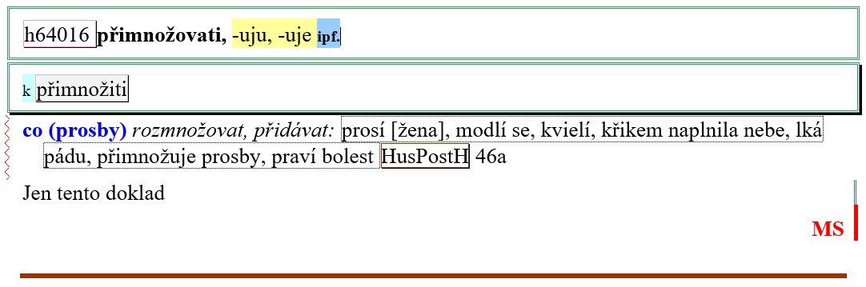
Digital Birth
Microsoft Word documents
  attached template
  paragraph and character styles
conversion from DOCX to XML TEI
  C# (for controlling process, XML manipulation)
  XSLT transformations

Slide 6
XML Format
starting with custom XML
  derived in 2000s from SGML
  originally developed for retrodigitized Old Czech Dictionary (1968–2008)
conversion to XML TEI P5
  XSLT transformations

Slide 7
Custom XML and TEI
<hw> → <form> + <orth>
<senseGrp> → <sense level="1|2">
<resp> → <note type="response"> + <persName full="abb">
<hwcolloc> → <form type="compound">

Slide 8
Presentation
on the Vokabulář webový website
  https://vokabular.ujc.cas.cz
  HTML + CSS
combined with entries from other (retrodigitized) dictionaries
“printed” version (PDF format)
  will follow in 2019 or 2020

Slide 9
Difficulties
preparing material for authors’ sections
combining data from:
  other dictionaries
  index cards (№ of quotations)
  entries from previous versions of EDOC (in DOCX format)

Slide 10
Difficulties with conversion
in DOCX documents
  using direct formatting instead of style
implici data, e.g.
  collocations in quotation marks
  Old Czech equivalent within definition in quotation marks
  location of cited quotation in primary sources after abbreviation

Slide 11
How to solve with TEI?
how to refer to external data
  e.g. from database
how to check structure validity
  e.g. with nested sense groups
    I. > A. > 1. OK × I. > 1. BAD
identification (xml:id) of the entries and headwords
  subject to change

Slide 12
How to solve with TEI?
where to keep information about morphemes
  e.g. naostřiti (na- and -o- = prefixes)
how to put headword in <note>
where should be information within teiHeader
  about authors of entries
  list of cited sources

Slide 13
Publication
which technology for PDF output?
  XSL-FO (no longer developed)
  CSS for Paged Media
  LaTeX
  InDesign + XML
  InDesign Markup Language + postprocessing

Slide 14
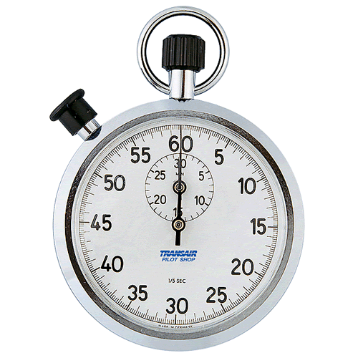
Time’s Up!
About your speaker:
  Name: Boris Lehečka
  Institution: Czech Language
  Institute of the Czech Academy
  of Sciences
  Quick bio: since 2000 working with dictionaries ((retro)digitization, publishing); programmer of the website Vokabulář webový (Web Vocabulary), since 2016 the head of the Research Infrastructure for Diachronic Czech Studies

